Slide 1
People Analytics:
Why IBM Workers Quit?
Bhawna Gupta, Hua Tu, Mingrui Zhou, Siyang Cheng

Slide 2

Index
Introduction
What is People Analytics
Introduction - Attrition, Dataset
Exploratory Data Analysis- Gender, Monthly Income, Department, Education Levels, Age, Job Title, Satisfaction
Predictive Analysis
Conclusions and Recommendations

Slide 3



What is People Analytics?
Introduction
A data-driven approach to managing people at work
Analytics applied to people issues - hiring, retention, compensation etc.
Firm’s greatest assets are its people

Slide 4
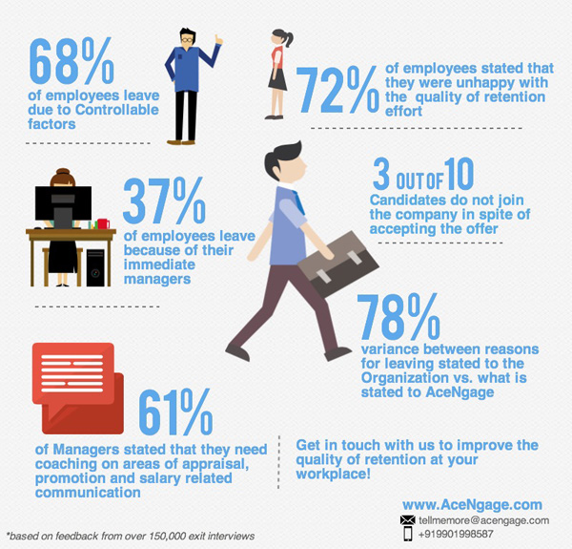
Attrition
Introduction
Turnover rate of employees inside an organization
Some possible Reasons:
Employees seeking for better opportunities.
A negative working environment.
Dissatisfaction with job
Bad management
Health condition of an employee (or even death)
Excessive working hours

Slide 5

About the Dataset
IBM HR Analytics Employee Attrition & Performance
Introduction
Fictional data set created by IBM data scientists
Uncover the factors that lead to employee attrition
Data structure: 1470 observations, 35 features
Data Type: factors and integers
Label: Attrition
https://www.kaggle.com/pavansubhasht/ibm-hr-analytics-attrition-dataset

Slide 6

Exploratory Data
Analysis on Attrition

Slide 7
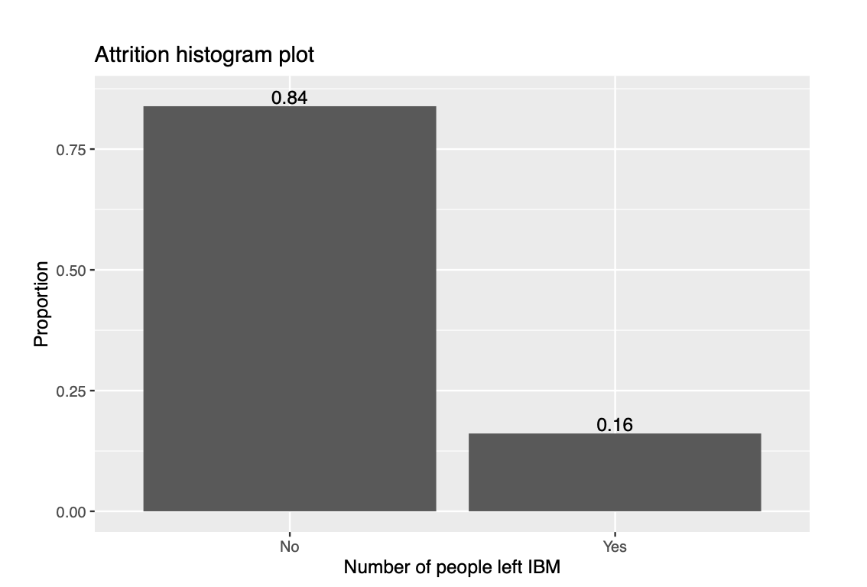
Imbalanced Dataset
Exploratory Data Analysis on Attrition
16% of the total employees left the organization while 84% of them stayed in the organization
The number of data points available for different classes varies
Dataset is imbalanced

Slide 8
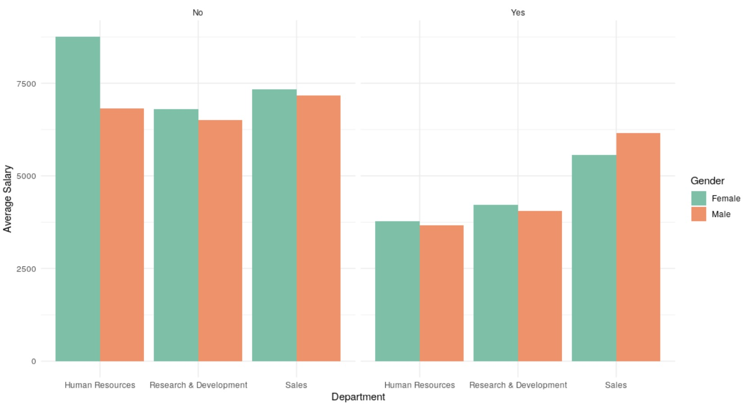
Average Salary by Department, Gender and Attrition
Exploratory Data Analysis on Attrition
In general, females earned higher salaries than males
Employees who left the organization were earning much less than employee who stayed
Among Attrition = No, average salary for human resources is the highest; When Attrition = Yes, average salary for sales is the highest

Slide 9
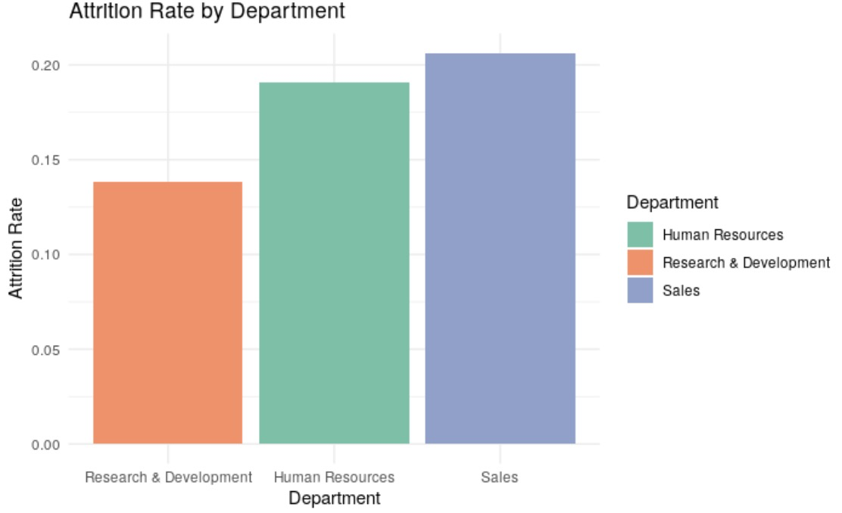
Attrition Rate by Department
Exploratory Data Analysis on Attrition
Employees working at sales department left the organization the most.
Employees working at Research and Development department are least likely to leave the company.

Slide 10
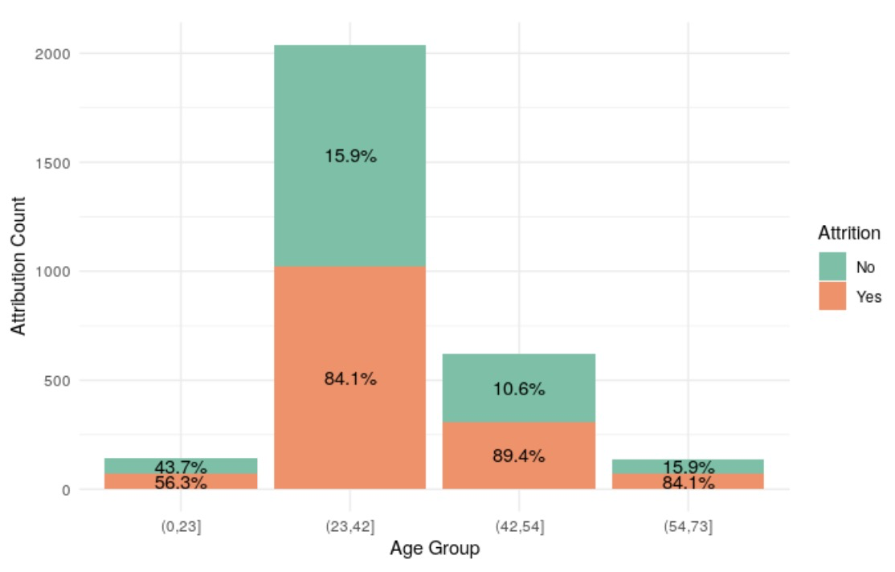
Attrition by Age Groups
Exploratory Data Analysis on Attrition
Age groups :
0-23 Gen Z
24-42 Gen Y
43-54 Gen X
55-73 Baby Boomers
For employees who are aged under 23, 43.7% of them left their job, which is the highest
For the age group 42-54, only 10.6% of them left the organization
Notes:
We created the age groups as Gen Z, Gen Y, Gen X and Baby Boomers. gen z as they opt to look more easy for other jobs that satisfy the needs; older people tend to stick to the org

Slide 11
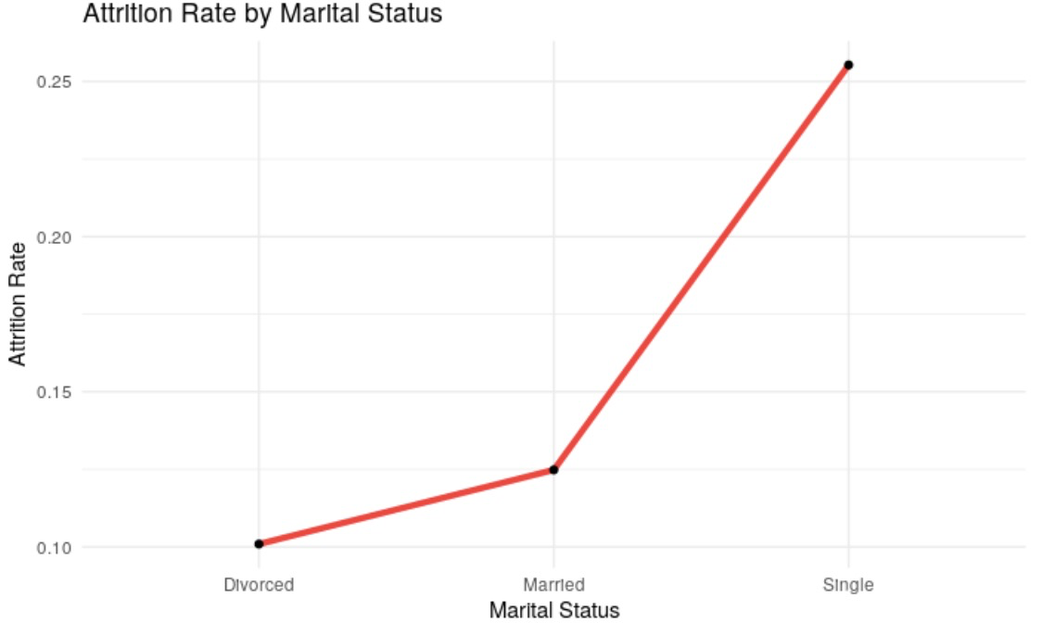
Attrition Rate by Marital Status
Exploratory Data Analysis on Attrition
Only 10% of employees who are divorced left the organization; they are least likely to leave the organization
Employees who are single are most likely to leave the organization that more than 25% of them left.

Slide 12
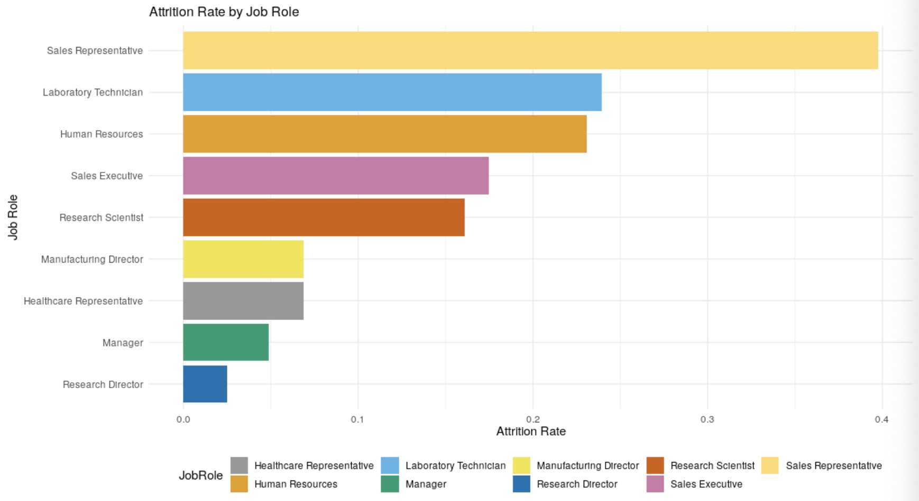
Attrition Rate by Job Role
Exploratory Data Analysis on Attrition
Sales representatives have strong tendency to leave their company
The attrition rate for laboratory technician and human resources are similar, with a percentage of around 0.23%
Directors, representatives, managers tend to have low attrition rate

Slide 13
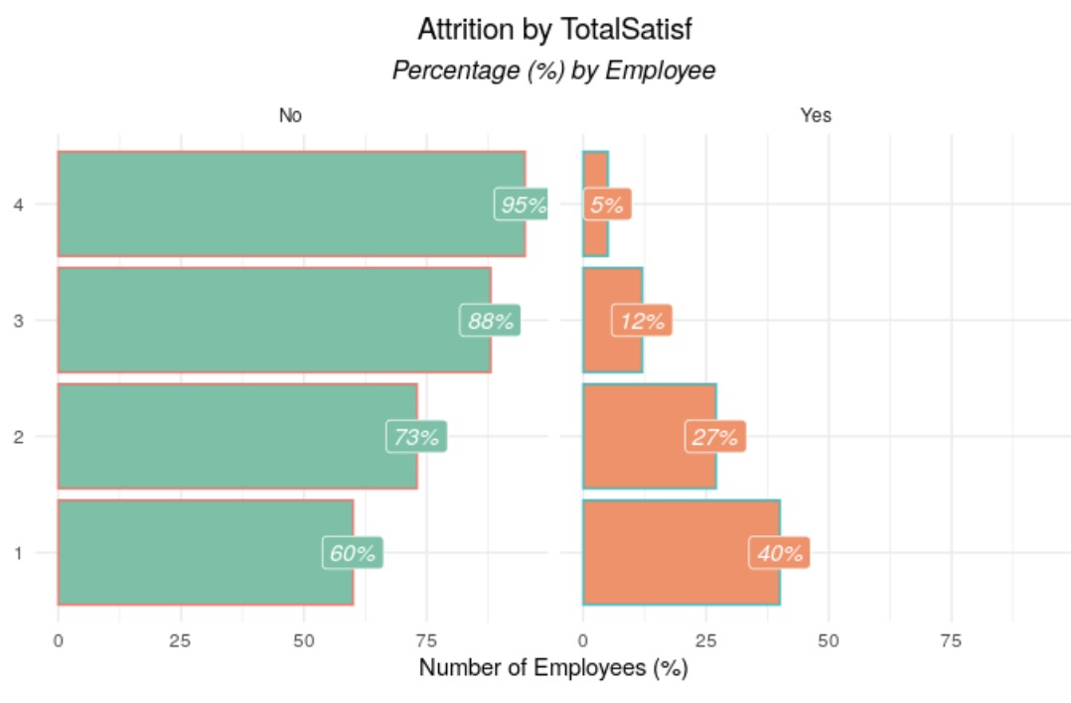


Attrition by Total Satisfaction
Exploratory Data Analysis on Attrition
Total Satisfaction ≈
1/5*
( Relationship Satisfaction +
Environment Satisfaction +
Job Satisfaction +
Job Involvement +
Work-Life Balance )
Total Satisfaction Level:
1 'Low' 2 'Medium' 3 'High' 4 'Very High'

Slide 14
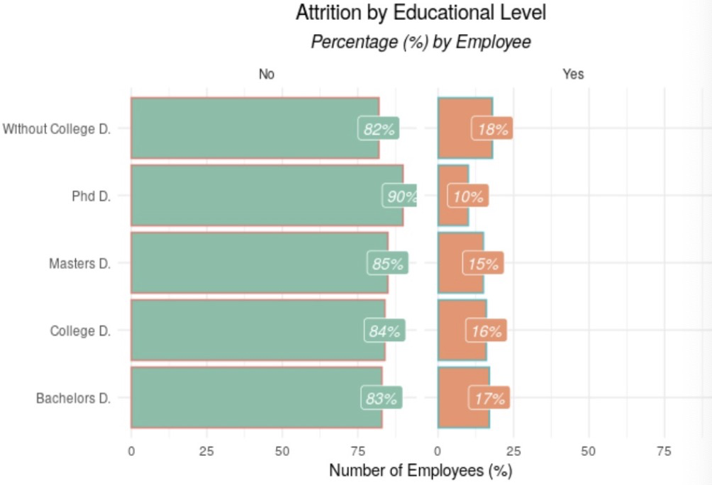
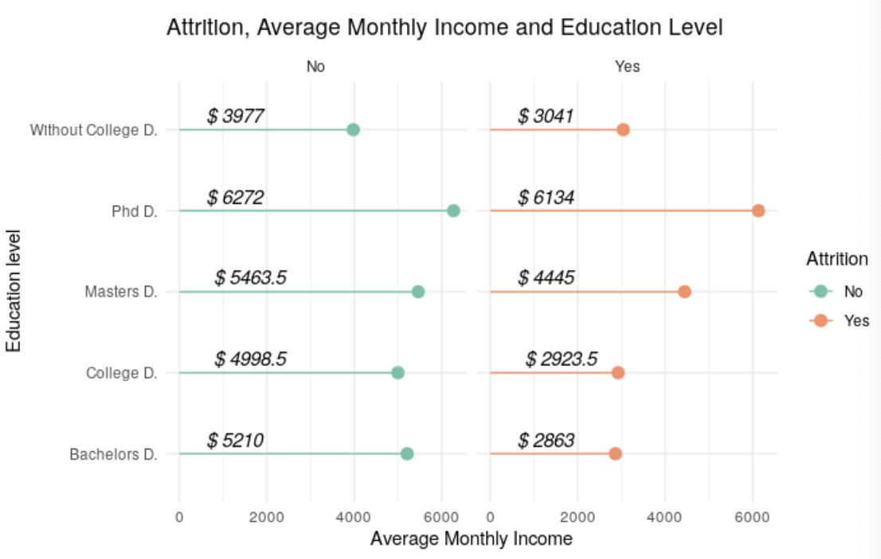
Attrition by Average Monthly Income& Education Level
Exploratory Data Analysis on Attrition
PhD - Small income gap & low attrition rate (red)
College, Bachelors - Huge income gap & high attrition rate(blue)

Slide 15
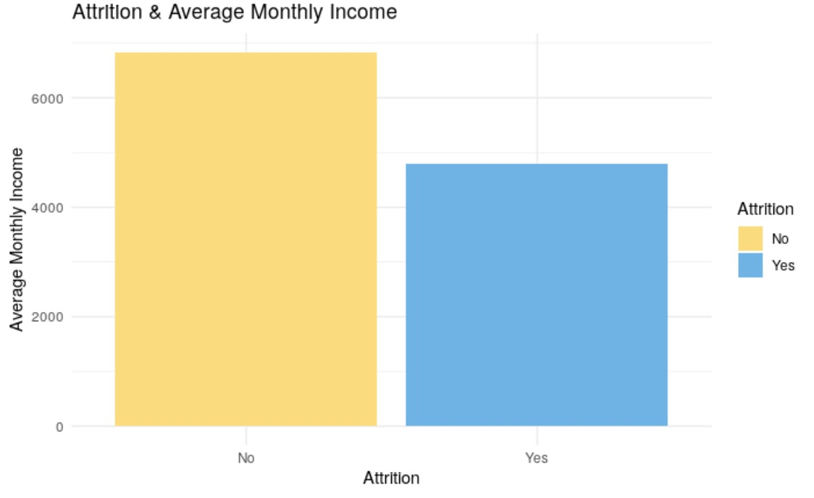
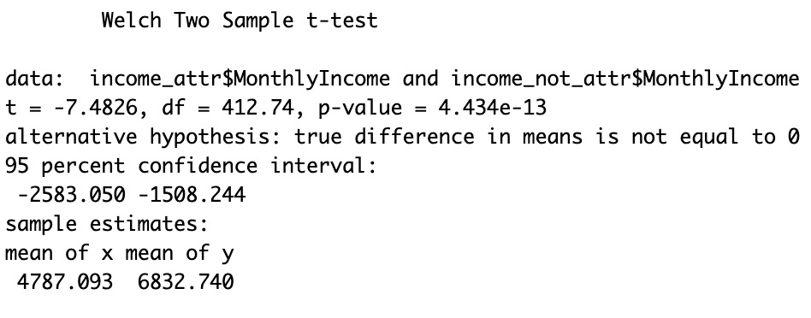
Attrition & Average Monthly Income
Exploratory Data Analysis on Attrition
Significant difference!

Slide 16
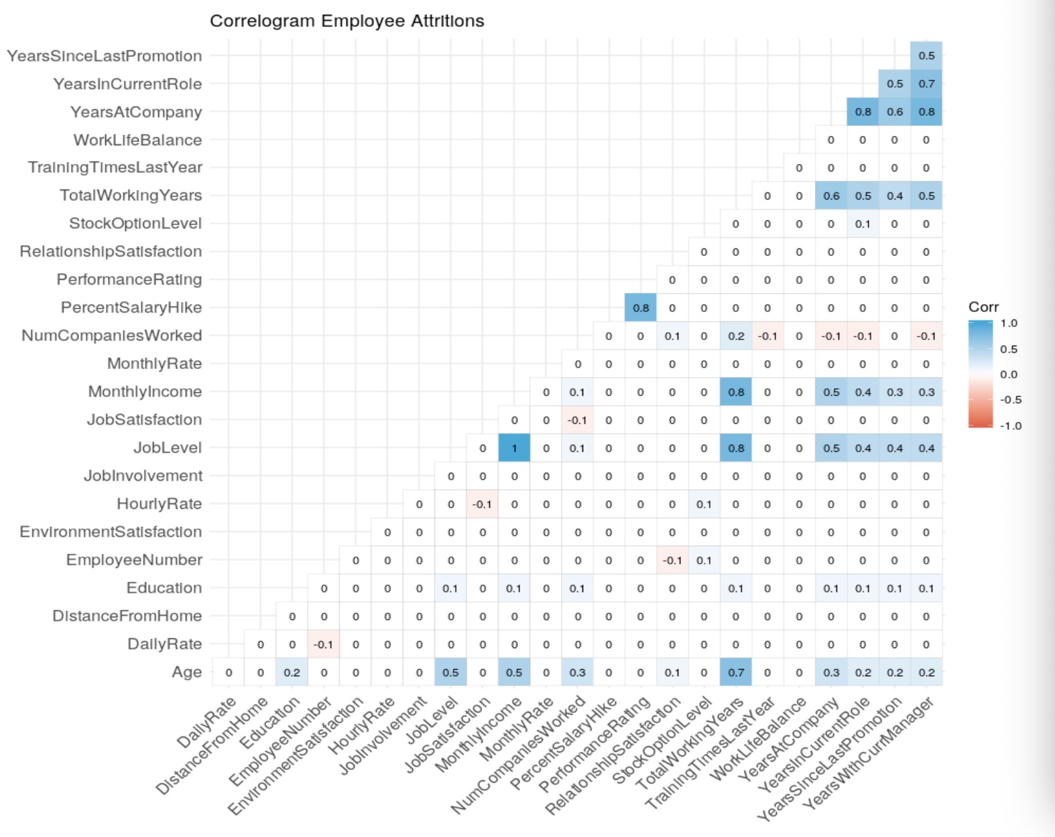
Feature Correlations
Exploratory Data Analysis on Attrition
Job level and monthly income are highly correlated
Job level and total working years are highly correlated
Monthly income and total working years are highly correlated

Slide 17

Predictive Analysis

Slide 18

Feature Engineering and Selection
Predictive Analysis
Based on our previous exploratory data analysis and correlation table, we selected features which we think contribute most to the predictive variable: Attrition
Fidelity is a feature generated by ourselves using Number of Companies worked / Total working years
A total of 22 features: 'Business Travel', 'Daily Rate', 'Department', 'Distance From Home', 'Education', 'Education Field', 'Employee Count', 'EmployeeNumber', 'Gender', 'Hourly Rate', 'Job Role', 'Marital Status', 'Monthly Income', 'Monthly Rate', 'OverTime', 'Percent Salary Hike', 'Performance Rating', 'Stock Option Level', 'Training Times Last Year', 'YearsAtCompany', 'Years In Current Role', 'Years Since Last Promotion', 'Years With Current Manager', 'overall_satisf', 'Age_bin', 'fidelity'

Slide 19
Model Design
Predictive Analysis
4 Models: Logistic Regression, Random Forest, Gradient Boosting Classifier, Ada Boost Classifier
Split data with 70% of training data and 30% of test data
Dealing with unbalanced data:
sample_weight = compute_sample_weight ('balanced', y_train)
gb_clf = GradientBoostingClassifier(n_estimators=20)
gb_clf.fit(X_train, y_train, sample_weight)
Test the trained model using the test set and cross validation

Slide 20
Comparison between Models
Predictive Analysis
Models | Accuracy rate on test set | Accuracy rate of cross validation
Random Forest | 87.30% | 87.53%
Gradient Boosting Classifier | 86.62% | 86.6%
Ada Boost Classifier | 86.62% | 86.74%
Logistic Regression | 87.12% | 87.06%
Random Forest has the highest accuracy rate on both test set and cross validation

Slide 21
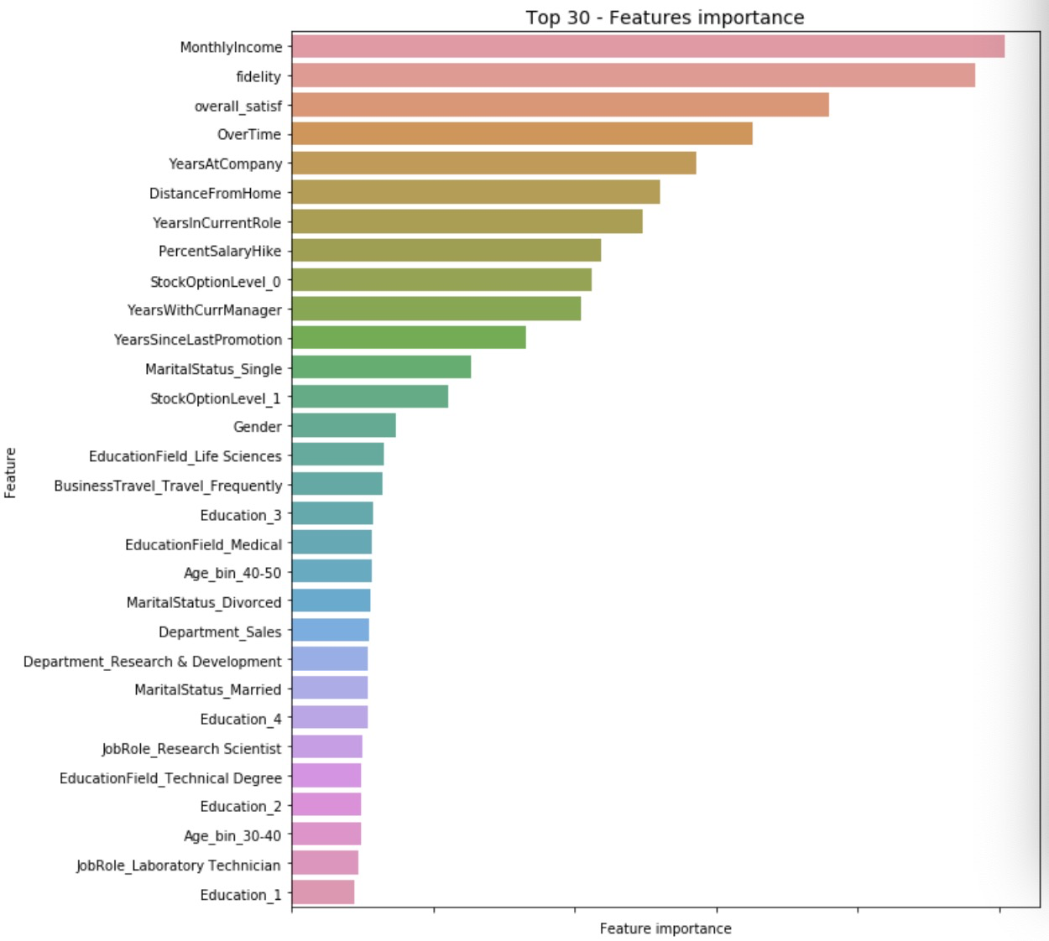
Top 30 important features
Predictive Analysis
Monthly Income: People who earned a higher income have low tendency to leave
Fidelity: If people switch jobs less often, it means they are also less likely to quit their jobs
Overall Satisfaction: People enjoy working when they feel satisfied with their jobs, environment and relationships, therefore have low possibility for attrition
Over-time: People don’t prefer jobs which require long working hours
Years at Company: If people work for a company for too long, it is easier to get a raise at a new job

Slide 22
Conclusions and Recommendations
The main general reason for attrition is the effort-reward imbalance.
People who work overtime or have low income have high tendency of leaving the job
IBM should check with their overtime policy that whether the overtime payoff is effective and limit on overtime hours
For IBM’s current work force, sales representatives have high possiblity for attrition
HR can check with recruiters’ fedelity when they hire sales representatives

Slide 23
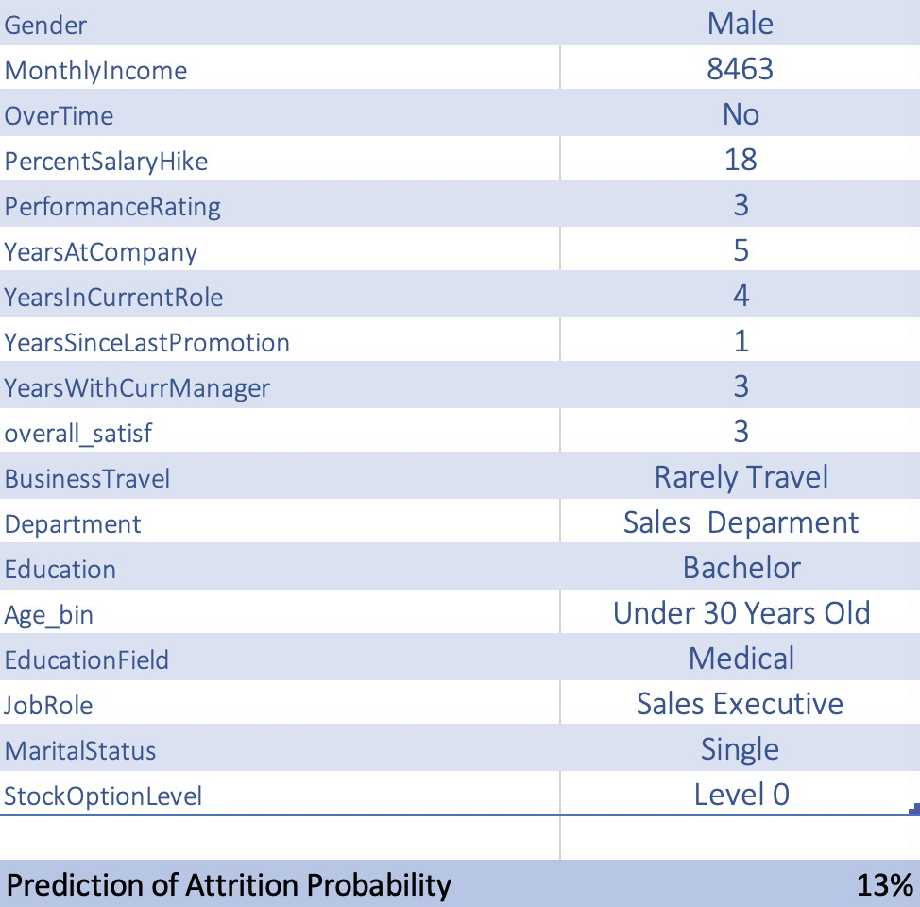
Conclusions and Recommendations
With our random forest model, IBM can apply it to calculate the possibilities of employees prone to leaving the company
With known information of an employee, we can calculate his probability of attrition

Slide 24
References
https://www.kaggle.com/pavansubhasht/ibm-hr-analytics-attrition-dataset
https://www.kaggle.com/arthurtok/employee-attrition-via-ensemble-tree-based-methods
https://www.kaggle.com/vincentlugat/ibm-attrition-analysis-and-prediction
https://www.kaggle.com/janiobachmann/attrition-in-an-organization-why-workers-quit
https://www.kaggle.com/aljaz91/ibm-s-attrition-tackling-class-imbalance-with-gbm

Slide 25

GROUP 2
GROUP 2

